Slide 1
Missing Value Imputation for Time Series with High Seasonality
Abhishek Bargujar
Supervisor: Prof. Anton Dignös
Master in Computing for Data Science
Free University of Bozen–Bolzano
March 2026

Slide 2
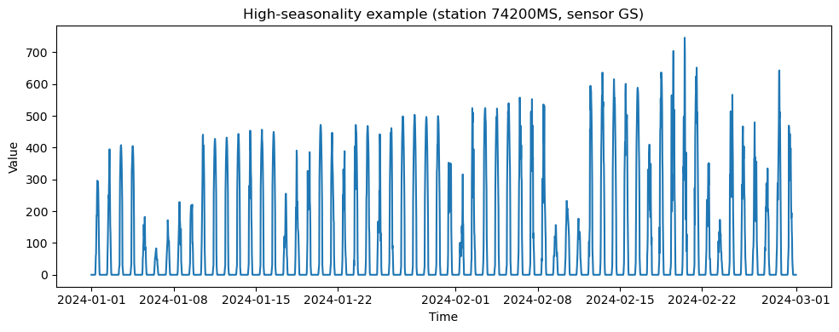
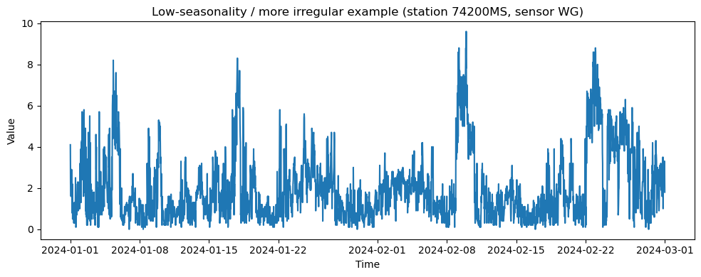
Context
Time Series: A sequence of data points recorded over time at regular intervals.
High seasonality: Strong repeating pattern occurring at fixed time intervals.
Missing Value: Unrecorded Data Points.
Missing Value Imputation: Missing Data Estimation.

Slide 3
Goal
Surveyed 56 algorithms to identify methods suitable for seasonal and phase-shifted data
Construct a seasonality-aware benchmark for time-series imputation
Extend the TKCM framework to better exploit seasonal and phase-shifted patterns
Analyze performance under different missingness scenarios (single vs block)
Identify when and why each method performs best

Slide 4
Challenges
Seasonal patterns repeat but are not always perfectly aligned (phase shifts)
Missing values may span entire seasonal segments known as block missing value (e.g., days or weeks)
Simple methods fail to capture long-range temporal dependencies
High seasonality can mislead similarity-based methods, if patterns are only partially matched
Most of the missing value Imputation methods use similar reference station (another time series) for rebuilding the missing value

Slide 5
Thesis Contributions
Methodological Contributions
Systematic survey of 56 imputation algorithms
Selection of 22 candidate methods (matrix-based, pattern-based, statistical modeling(Model Based))
Identification of 7 algorithms suitable for seasonal and phase-shifted time series
Construction of a benchmark for comparative evaluation
Extensions of TKCM
Weighted TKCM
TKCM Plus
TKCM Pro
Experimental Evaluation
Evaluation on South Tyrol Weather dataset (Open Data Portal)
172 stations (valley, mountain, river-gauging), 3-9 sensors per station
12 sensor types (air temp, humidity, wind speed, water temp, solar radiation)
Time range : 2023-01-01 to 2025-01-01, 30-minute granularity
Large-scale experiments on seasonal real-world data

Slide 6
Implementations
Unified Python framework
All algorithms (baseline, benchmark, and TKCM variants including extensions such as Weighted TKCM, TKCM PLUS, TKCM PRO) were reimplemented from scratch in Python to ensure fair comparison.
Common pipeline
identical preprocessing
same missingness injection strategy
same evaluation metrics (MAE, RMSE)
TKCM-based implementation
sliding window matching (parameter K -> nearest patterns)
reference series selection (parameter L -> pattern length/ reference selection)
configurable similarity and weighting schemes
Parameter tuning
grid search over k, l, α, β
α controls the influence of the known values of the target time series.
β controls the influence of the reference stations.
tuning performed per dataset and missingness scenario
Scalability
implemented to handle large-scale seasonal time series
supports single-point and long block missing values

Slide 7
Related Work and Benchmark Motivation
Existing studies (e.g., ImputeVIS, Mind the Gap) show that no single imputation method performs best in all scenarios[1],[2]
Imputation performance strongly depends on [3][1]:
data characteristics
missingness type (single vs block)
Matrix-based and model-based methods[4] perform well for large missing blocks
Pattern-based methods (e.g., TKCM) are effective for repetitive and seasonal patterns[4]
Benchmark Motivation
Most existing benchmarks do not explicitly focus on highly seasonal data with possible phase shifts, which are common in real-world sensor datasets.
This gap motivates the construction of a seasonality-aware benchmark to fairly compare different imputation methods and understand when each approach performs best.
References [1] Khayati et al. (2020). Mind the Gap: Experimental Evaluation of Missing Value Imputation in Time Series. PVLDB, 13(5), 768–782. [2] Khayati et al. (2024). ImputeVis: Interactive Benchmarking of Time Series Imputation Techniques. PVLDB, 17(12), 4329–4332. [3] Khayati & Böhlen (2012). REBOM: Recovery of Blocks of Missing Values in Time Series. COMAD 2012. [4] Wellenzohn et al. (2017). Continuous Imputation of Missing Values in Pattern-Determining Time Series. EDBT 2017.

Slide 8
Selected Imputation Methods for Seasonality
Pattern-Based Methods These methods reconstruct missing values by matching and reusing similar historical patterns in the data.
TKCM exploits repeating historical patterns for seasonal and phase-shifted data [4].
ST-MVL leverages spatio-temporal similarity between nearby sensors [9].
Matrix-Based Methods These methods treat the data as a matrix and recover missing values by exploiting low-rank global structure.
CDRec robust reconstruction of long missing blocks using centroid decomposition [3].
SoftImpute low-rank matrix completion with regularization [6].
SVDImpute low-rank approximation via singular value decomposition [5].
TRMF imputes missing values by combining low-rank matrix factorization with autoregressive temporal modeling to capture both global structure and time dependencies [7].
Model-Based Method These methods estimate missing values by fitting a probabilistic or dynamical model to describe how the data evolves over time.
DynaMMo dynamic matrix completion using Kalman filtering and Expectation–Maximization (EM) [8].
References [5] Cai et al. (2010). A Singular Value Thresholding Algorithm for Matrix Completion. SIAM J. Optim. [6] Mazumder et al. (2010). Spectral Regularization Algorithms for Learning Large Incomplete Matrices. JMLR. [7] Yu et al. (2016). Temporal Regularized Matrix Factorization for High-Dimensional Time Series Prediction. NeurIPS. [8] Li et al. (2009). DynaMMo: Mining and Summarization of Coevolving Sequences with Missing Values. KDD. [9] Yi et al. (2016). ST-MVL: Filling Missing Values in Geo-Sensory Time Series Data. IJCAI.

Slide 9
Extensions of TKCM Framework
Motivation
Improve robustness under phase shifts and complex seasonal patterns
Better exploit multiple reference stations
Reduce sensitivity to pattern selection
1. Weighted TKCM
Assigns higher weights to reference patterns that are more similar to the missing segment
Reduces influence of weakly matching anchors
Improves stability in seasonal and noisy environments
2. TKCM PLUS
Combines information from: Reference series and Known values of the target series
Introduces tunable parameters (α, β)
Allows flexible balance between external and internal information
3. TKCM PRO
Aggregates all reference series jointly
Uses global averaging instead of independent matching (only same signals)
Reduces variance in high-variability settings

Slide 10
Experimental Setup

Slide 11
Missingness

Slide 12
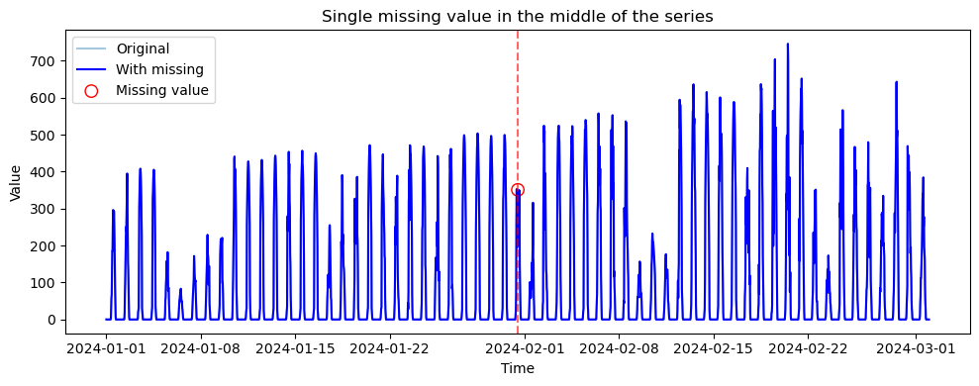
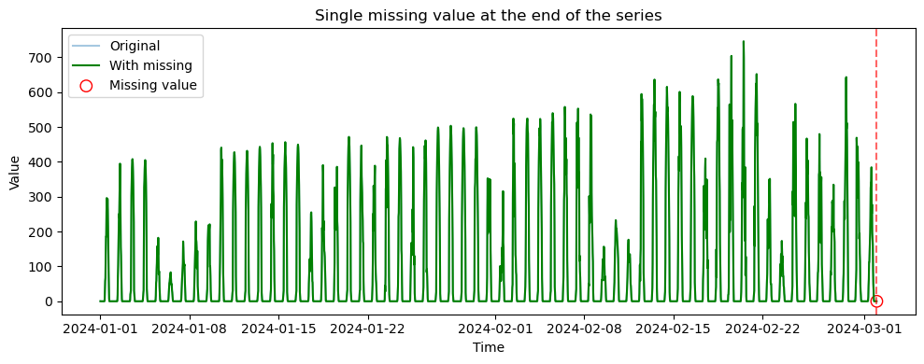
Single Point Missing Values

Slide 13
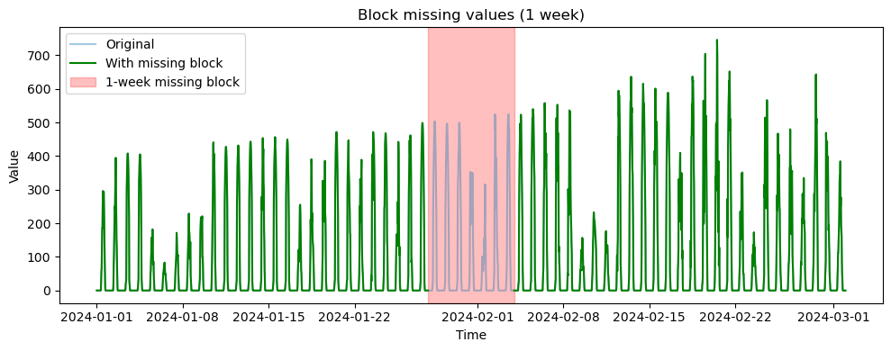
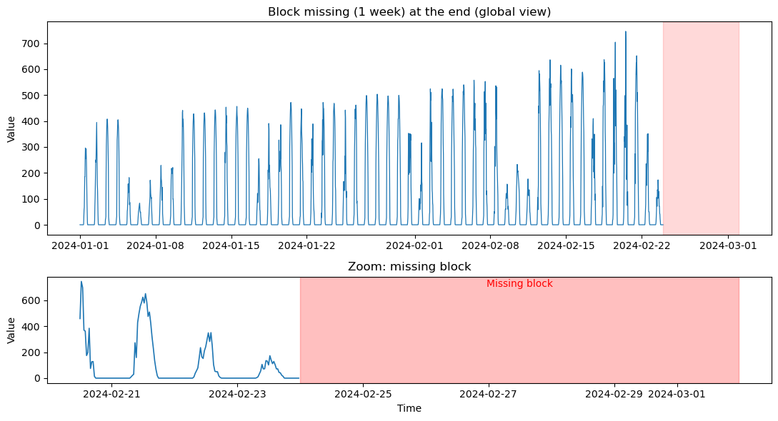
Block Missing Values

Slide 14
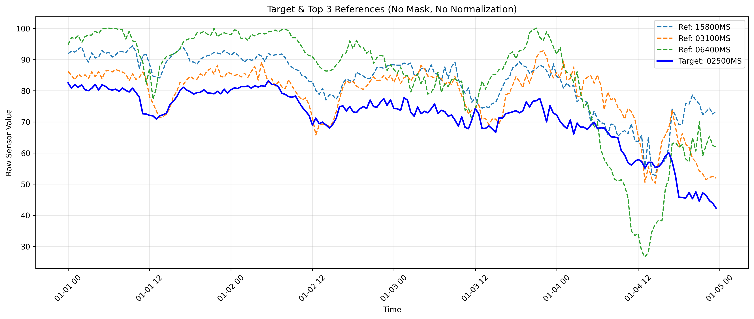
Experimental Setup – Target & Reference Selection
All approaches use reference stations for the imputation.
Dataset: Valley stations – South Tyrol weather data
Target station: 02500MS (Atmospheric Pressure – LF)
Reference selection: Top 3 stations selected using Pearson correlation
Same target & references used across all valley experiments and same approach was used for mountain, river-gauging datasets

Slide 15
Settings & Metrics
Sensors analyzed
Air Temperature
Humidity
Water Temperature
Reference Selection
Pearson Correlation
Euclidean distance
Parameter Tuning
grid search over window size (k -> nearest patterns and Historical Patterns)
number of anchors (l -> pattern length, reference selection)
Evaluation Metrics
RMSE(Root Mean Square Error)
MAE(Mean Absolute Error)

Slide 16
RESULTS

Slide 17
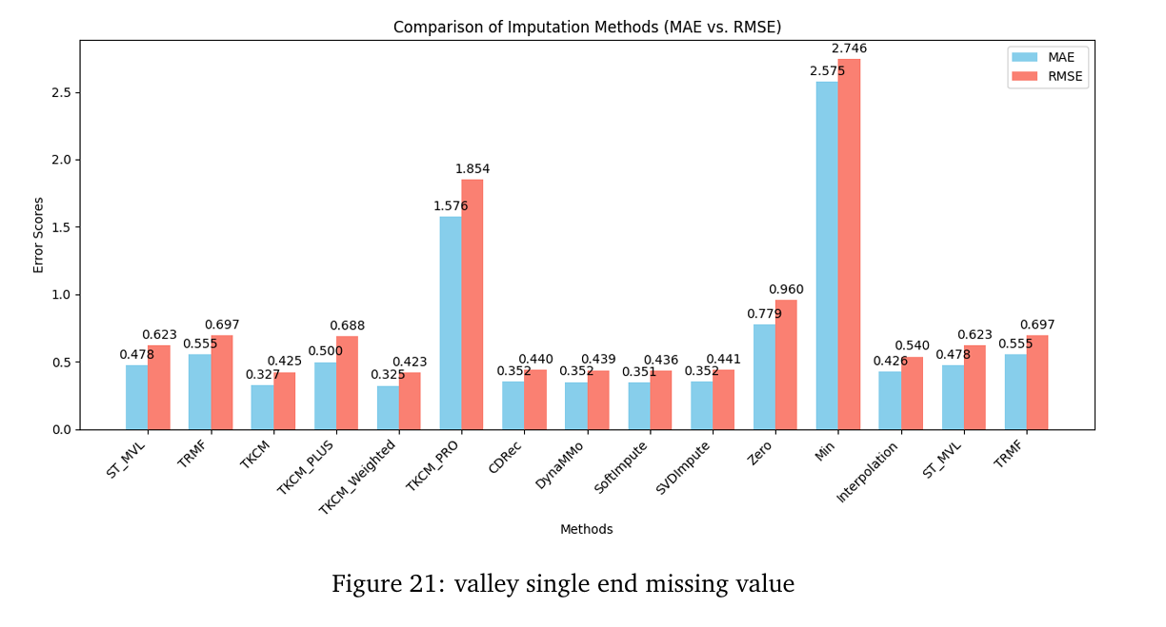
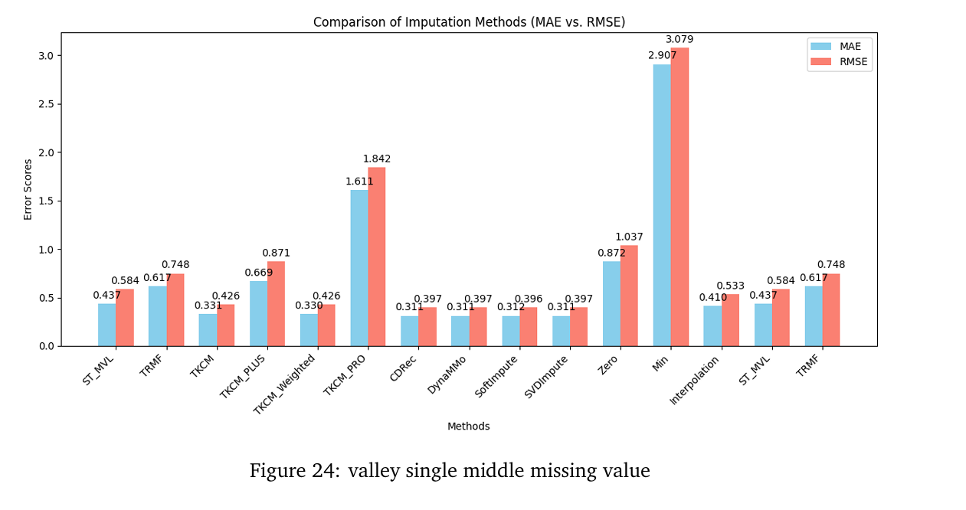
Single Missing Value Analysis (End vs Middle)
Setting: Single missing value at the end and middle of the time series
Valley Stations (High Seasonality)
TKCM & Weighted TKCM achieve the lowest MAE and RMSE
Pattern-based methods benefit from strong seasonality
Baseline methods (Min, Zero) fail due to phase shifts
Mountain Stations (Higher Variability)
Matrix- and model-based methods dominate
SoftImpute, SVDImpute, DynaMMo
TKCM variants remain competitive
Gauging Stations (Strong Local Continuity)
Interpolation and matrix-based methods perform best
Simpler structure favors smooth reconstruction

Slide 18
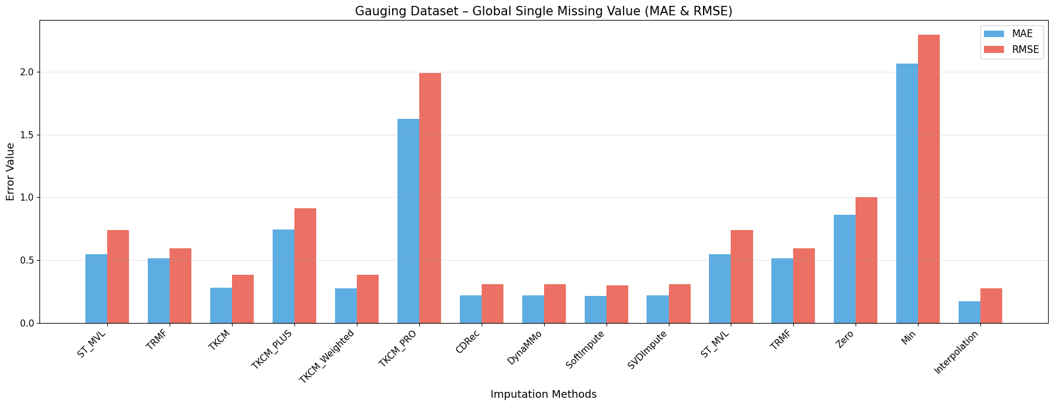
Global Single Missing Values
Setting: Single missing values distributed globally
Valley Stations (High Seasonality)
CDRec, DynaMMo, SoftImpute, and SVDImpute achieve the best performance
TKCM variants are slightly worse but remain competitive
Mountain & Gauging Stations (Higher Variability, Strong Local Continuity)
SoftImpute, DynaMMo, and CDRec consistently achieve the best performance
Performance is driven by higher variability and smoother temporal structure
Baseline Methods
Extremely poor performance across all datasets
Unsuitable for seasonal and phase-shifted time series

Slide 19
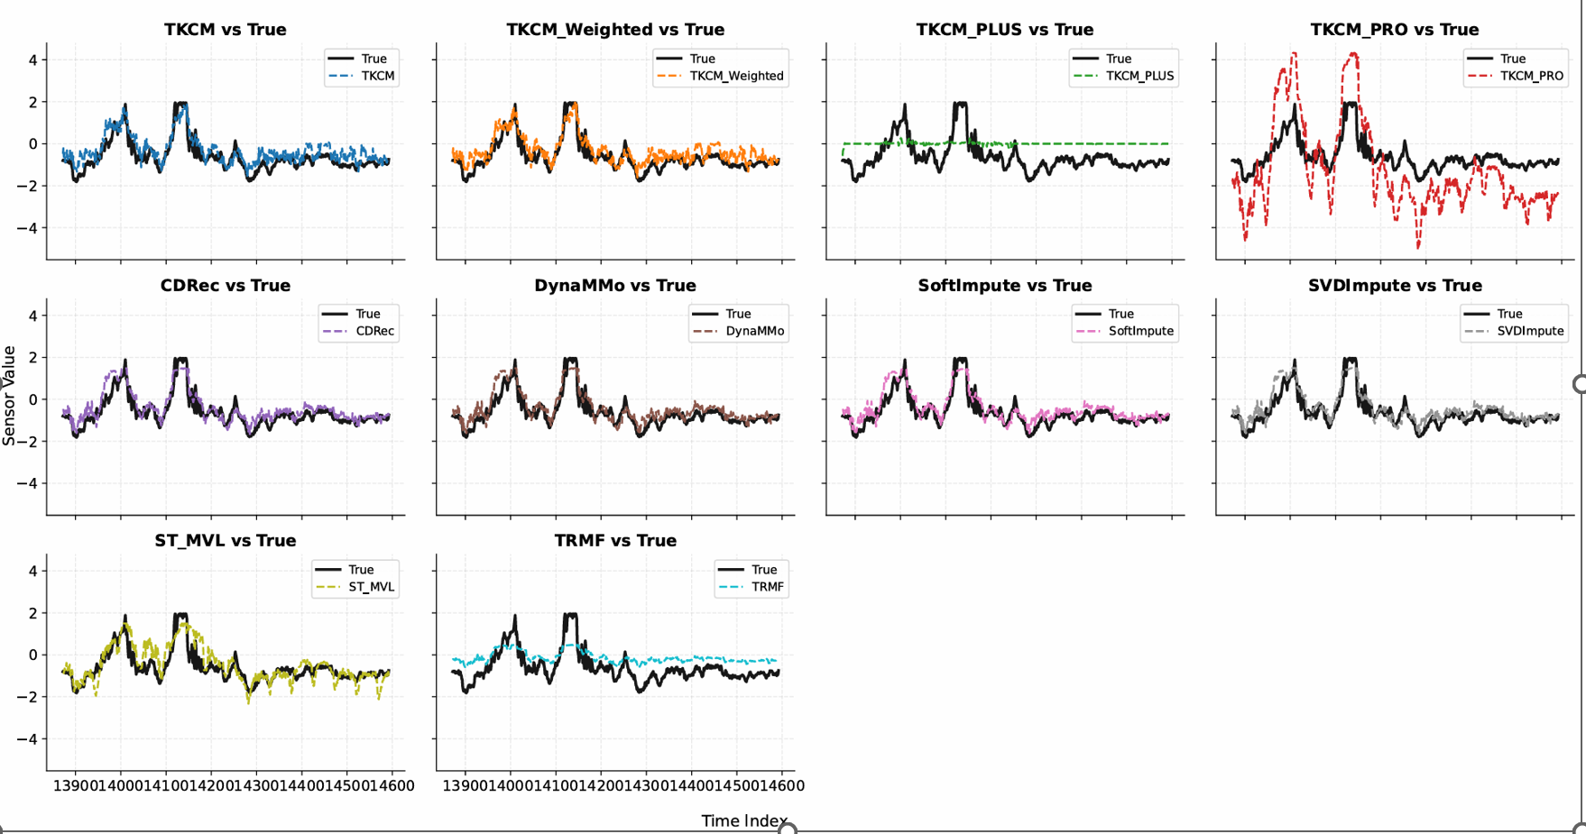
Block Missing (End)
Setting: Continuous missing block at the end of the time series
Valley & Mountain Stations (High Seasonality, Higher Variability) 1. CDRec, DynaMMo, SoftImpute, SVDImpute achieve the lowest errors 2. Matrix- and model-based methods handle long missing blocks more robustly 3. TKCM variants struggle when sufficient historical anchors are unavailable
Gauging Stations (Strong Local Continuity) 1. Linear interpolation achieves the lowest error 2. Strong local temporal continuity favors simple methods 3. Matrix-based methods follow closely 4.TKCM and Weighted TKCM perform worst in this setting

Slide 20
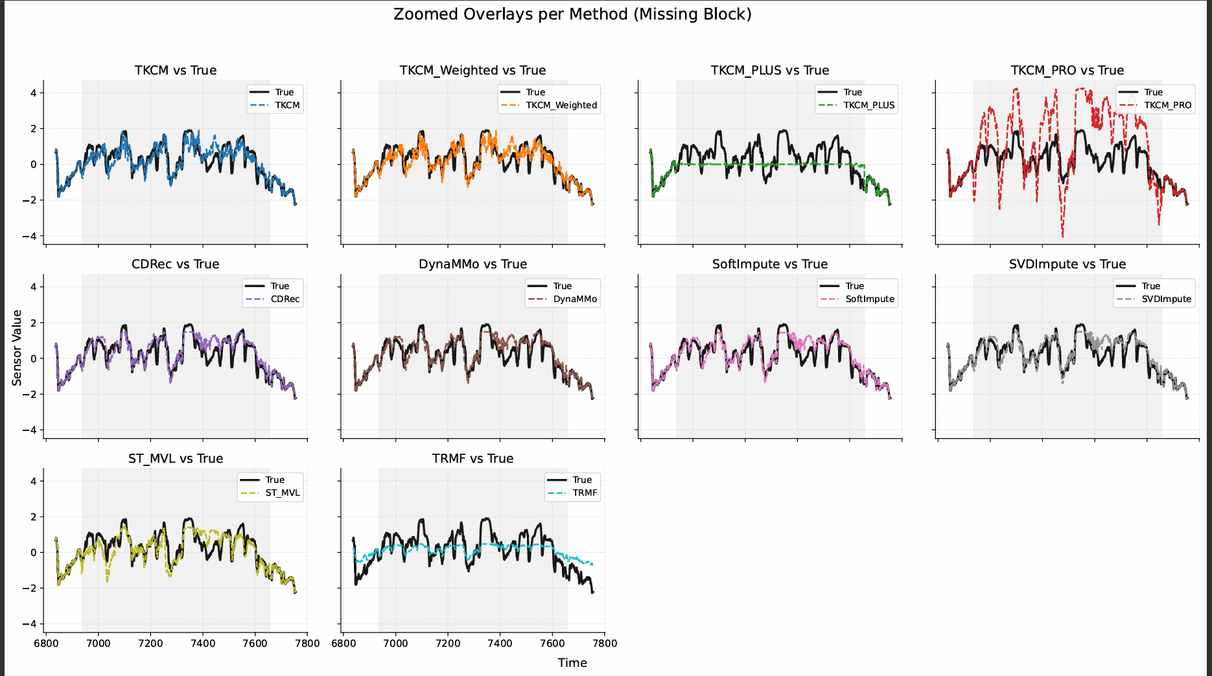
Block Missing (Middle)
Setting: Continuous missing block in the middle of the time series
Valley Stations (High Seasonality)
SoftImpute achieves the lowest MAE and RMSE
CDRec and SVDImpute closely follow
TKCM & Weighted TKCM perform well but require tuning
TKCM Plus, TKCM Pro, TRMF perform poorly without sufficient
anchors
Mountain Stations (Higher Variability)
DynaMMo, SoftImpute, SVDImpute are strongest
Matrix- and model-based methods handle variability better
TKCM variants are less robust in mid-block gaps
Gauging Stations (Strong Local Continuity)
Performance degrades for most methods due to:
missing values in both target and reference stations
SoftImpute, DynaMMo, SVDImpute remain most stable
TKCM variants perform worst in this setting

Slide 21
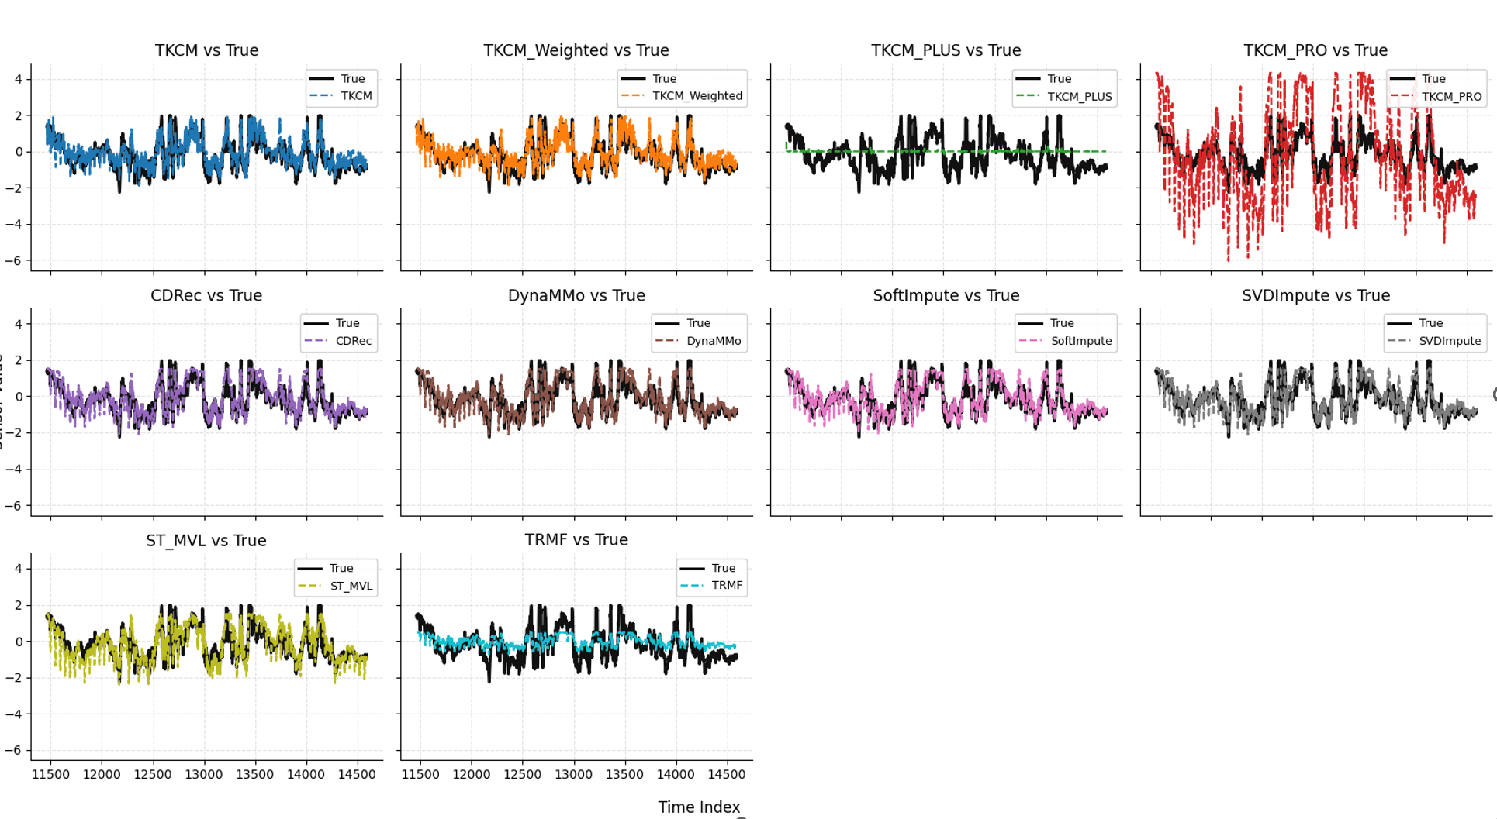
Block Missing (Middle – Long Blocks)
Setting: Missing block of 1 month in the middle of the series and
Severe information loss.
Key Findings
Best-performing methods:
SoftImpute
CDRec
SVDImpute
TKCM & Weighted TKCM:
performance improves after tuning (k, l)
still inferior to matrix-based methods
Worst performers:
TKCM Pro
TRMF

Slide 22
Discussion
Method
Matrix-based and model-based methods: (CDRec, DynaMMo, SoftImpute, SVDImpute) consistently perform best for single missing values
TKCM and Weighted TKCM:
competitive in single-missing settings
performance improves significantly after parameter tuning
Baseline methods (Min, Zero):
high error
unsuitable for seasonal and phase-shifted data
Block Missing Value Analysis
CDRec, DynaMMo, SVDImpute:
most reliable for long missing blocks
stable even for one-month gaps
TKCM-based methods:
weaker with default parameters
improve substantially after tuning (k, l)
Performance strongly depends on:
data characteristics
missingness pattern
parameter

Slide 23
Conclusion and Future Work
Conclusion
Surveyed 56 imputation algorithms, selected & benchmarked 22, identified 7 suitable for seasonal data.
Constructed a seasonality-aware benchmark
Extend the TKCM framework to better exploit seasonal and phase-shifted patterns
Analyze performance under different missingness scenarios (single vs block)
TKCM-based methods are competitive and particularly effective for single missing values.
Matrix- and Model-based methods perform best for long missing blocks in seasonal time series.
Future Work
Hybrid models combining matrix and pattern-based approaches.
Improve similarity measures:
Gaussian weighting,
Dynamic Time Warping (DTW),
Edit distance.
Integrate automatic parameter tuning directly into the TKCM framework and reduce computation cost while preserving imputation accuracy.

Slide 24
THANK YOU

